Slide 1
6th Grade Practice Questions

Slide 2
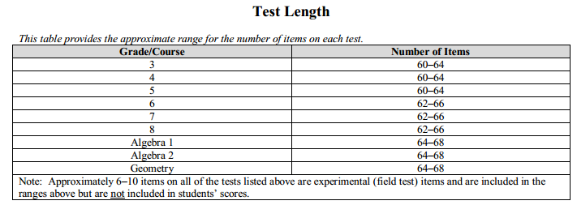
6th Grade Math FSA
The Number of Questions:
What will the test be like?

Slide 3
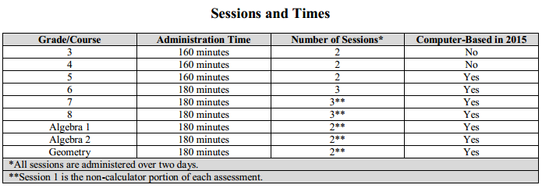
6th Grade Math FSA
How Long is the Test?
What are the Levels of Complexity?
What will the test be like?

Slide 4
6th Grade Math FSA
Does Your Child Need Computer Skills?
When is the Sixth Grade Test?
The district testing dates for grades 5 through
8 is April 13th through May 8th 2015.
What will the test be like?

Slide 5
The Practice Test
User id: MLMS-FCAT
Password: testing
Or Students: Use your own account
Parents: Join the SCPS Public Wi-Fi.
Launch a browser such as Firefox or
Chrome.
Go to FSASSESSMENTS.ORG
Log On to Our Computers

Slide 6
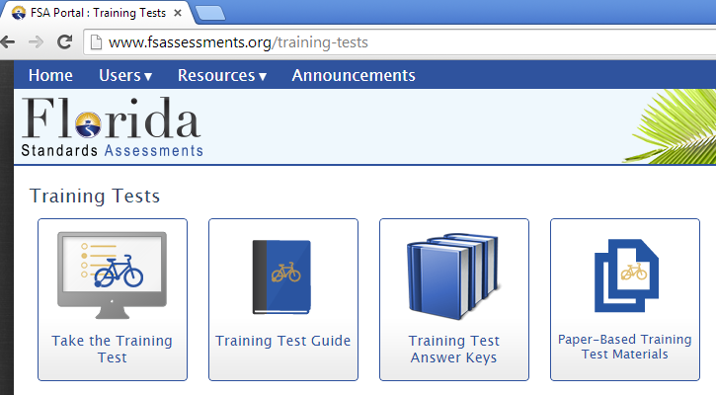
The Practice Test
www.fsassessments.org/training-test
Select Take the Training Test

Slide 7
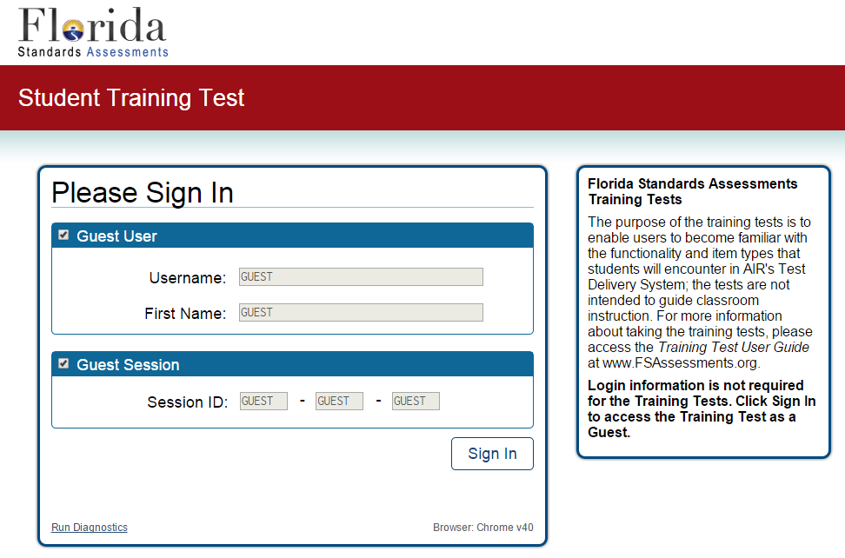
The Practice Test
You will be signing in as a guest, so click Sign In.

Slide 8
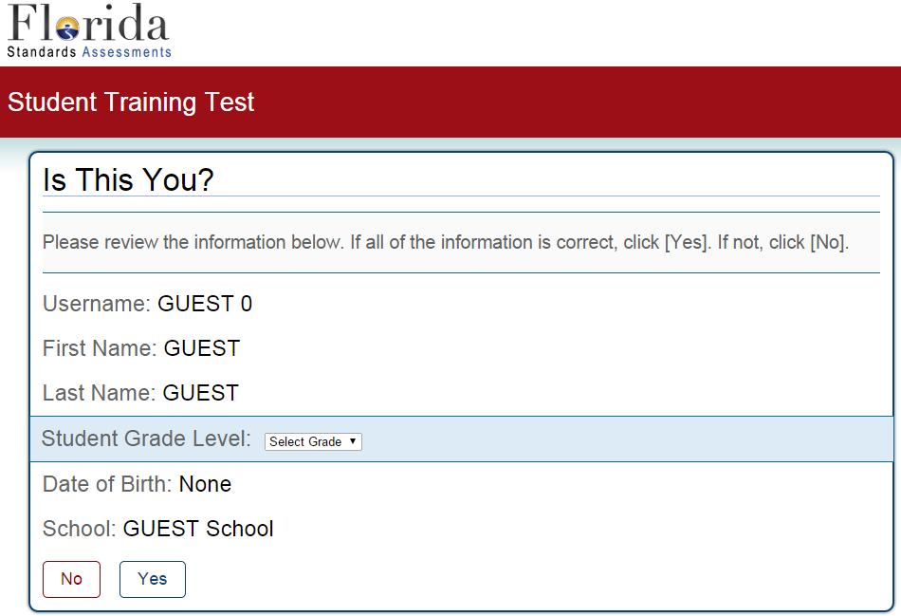
The Practice Test
Select 6th Grade
Click Yes

Slide 9
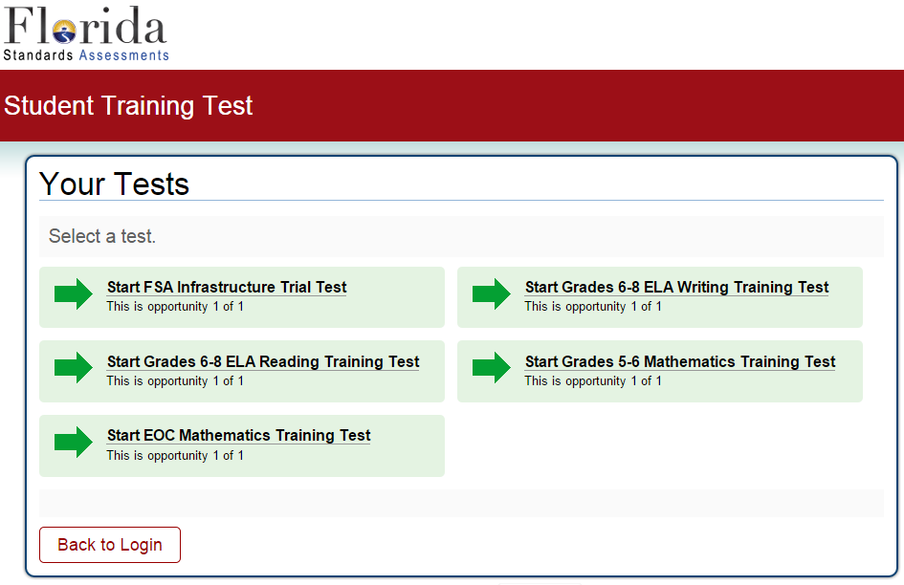
The Practice Test
Select 5th and 6th Grade Mathematics

Slide 10
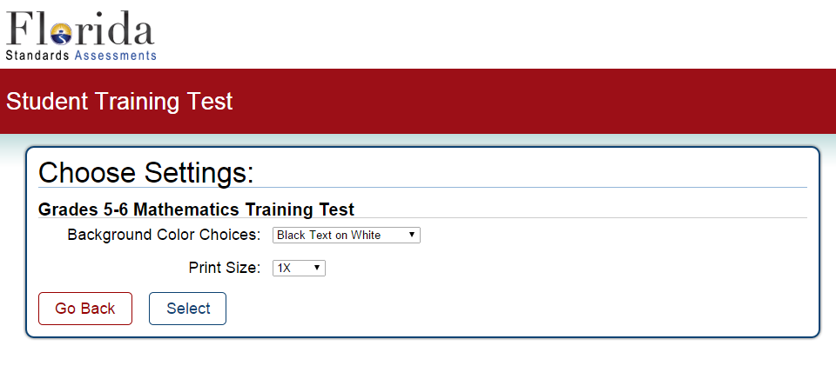
The Practice Test
Accept or Change Preferences and Click Select

Slide 11
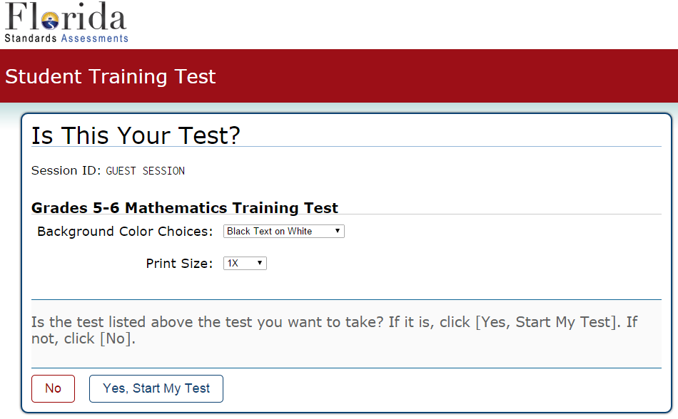
The Practice Test
You are asked one final time if this is the correct test.
Click “Yes, Start My Test.”

Slide 12
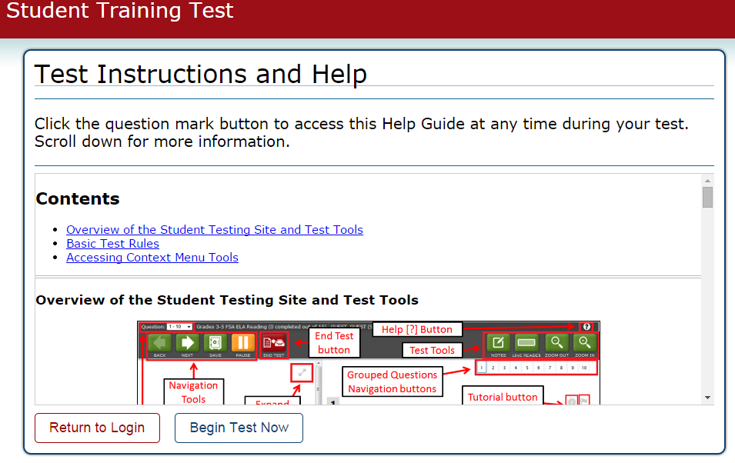
The Practice Test
Click Begin Test Now

Slide 13
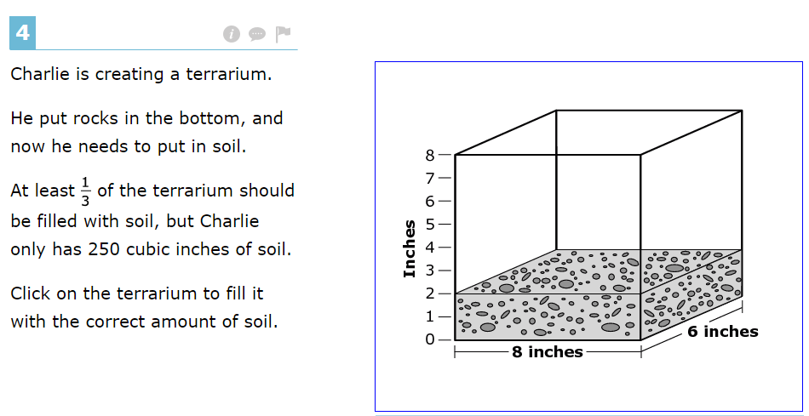
Answer
Click Here

Slide 14
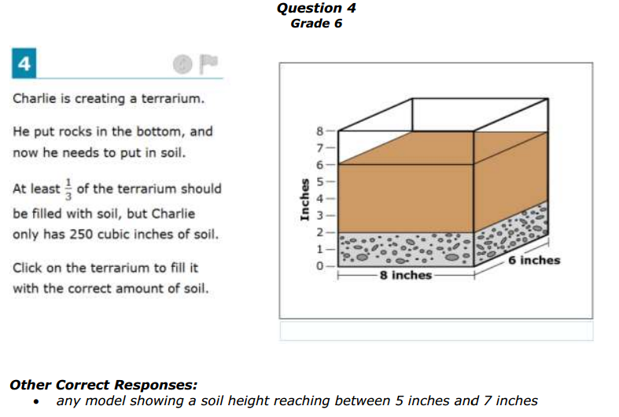
Solution
The entire terrarium holds 384 cubic inches. 8 × 6 × 8
1/3 of 384 = 128 cubic inches.
H (4) is 2 inches of soil = 96 cubic inches of soil (not enough because not 1/3)
H (8) is 6 inches of soil = 288 cubic inches of soil (you don’t have that much.)
The values between heights of 5 inches and 7 inches are equivalent to 3, 4 and 5 inches of soil. They equate to 144, 192 and 240 cubic inches of soil. All three meet the requirements.

Slide 15
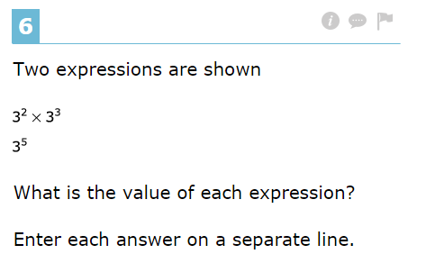
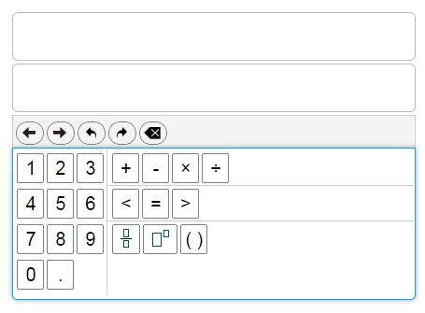
Answer
Click Here

Slide 16
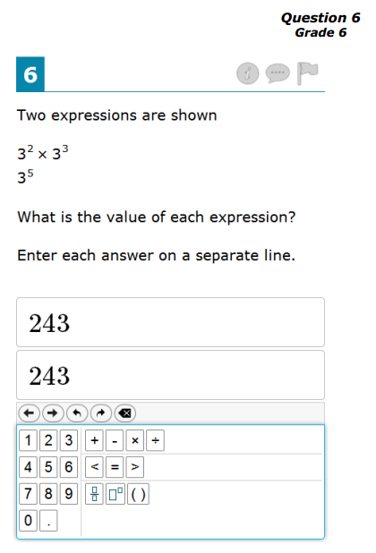
Solution
When expanded, both expressions are equivalent.
3 × 3 × 3 × 3 × 3
9 × 3 × 3 × 3
27 × 3 × 3
81 × 3
243

Slide 17
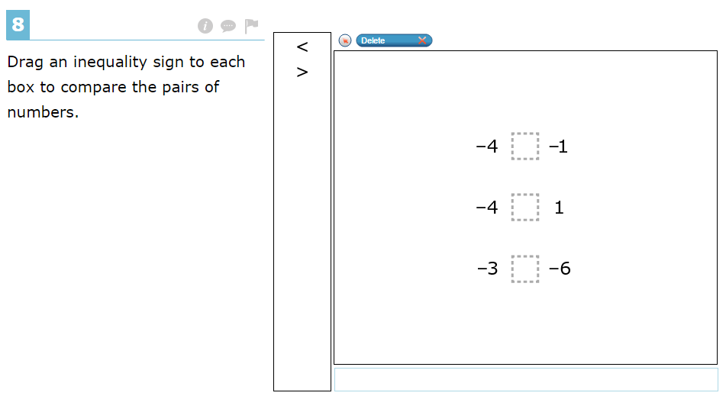
Answer
Click Here

Slide 18
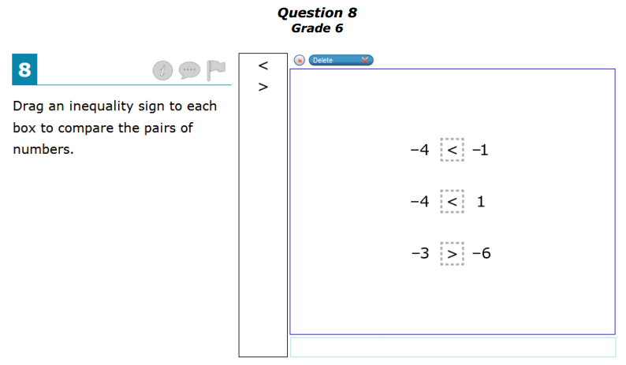
Solution
Numbers decrease in value as you move left on a number line.

Slide 19
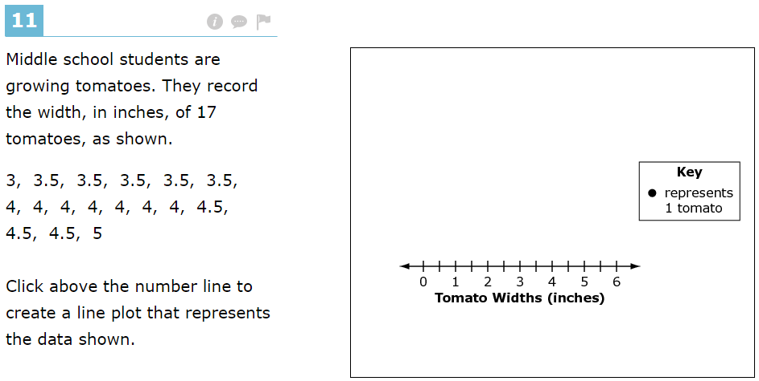
Answer
Click Here

Slide 20
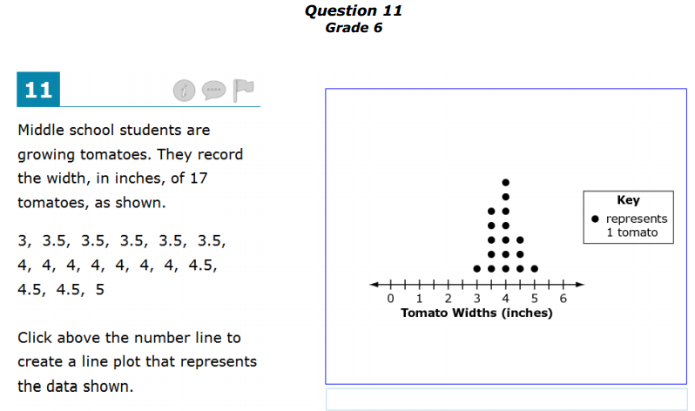
Solution
There is one occurrence of 3, five occurrences of 3.5, seven occurrences of 4, three occurrences of 4.5 and one occurrence of 5 in the data set given.

Slide 21
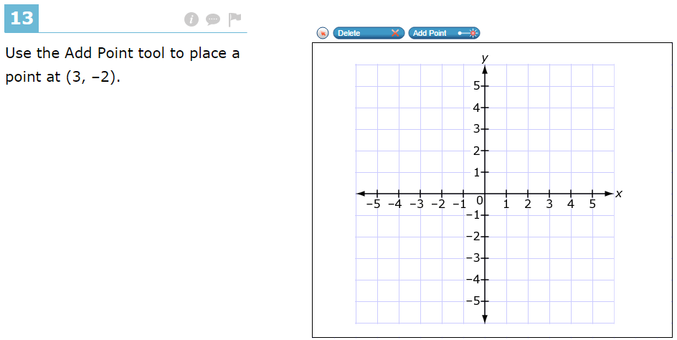
Answer
Click Here

Slide 22
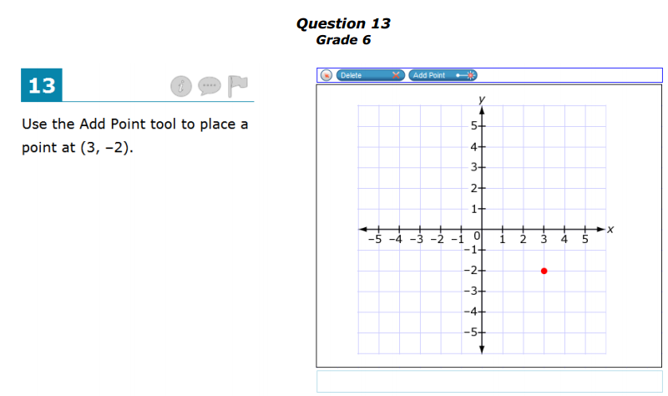
Solution
Ordered pairs are always x then y (x, y) and are graphed with respect to the origin. So, from the origin (0,0) you go right three (+3) and down two (-2).

Slide 23
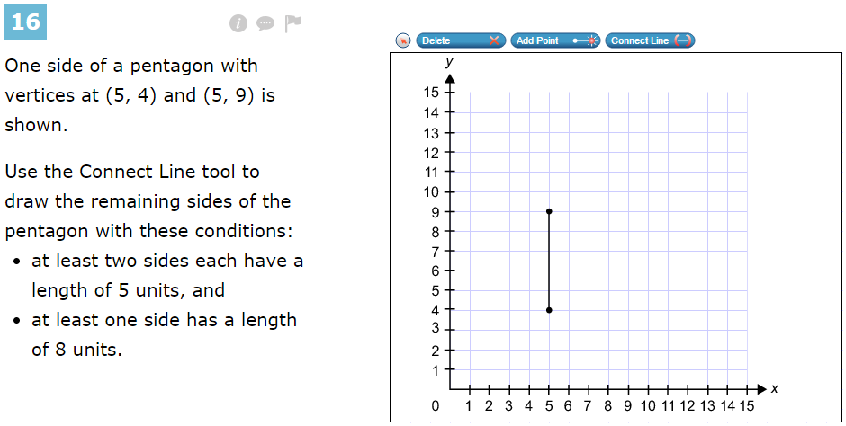
Answer
Click Here

Slide 24
Solution
5 units
5 units
8 units
Students must know that a pentagon has five sides.

Slide 25
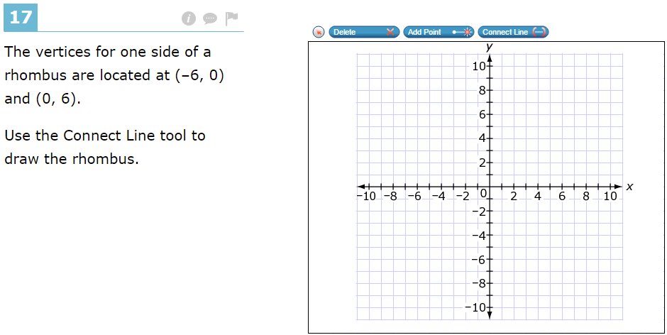
Answer
Click Here

Slide 26
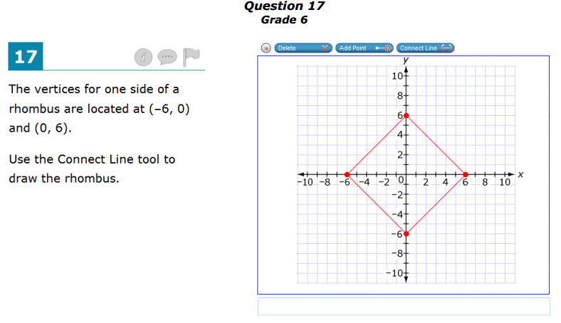
Solution
Students must know that a rhombus has four equal length sides with congruent opposite angles.

Slide 27
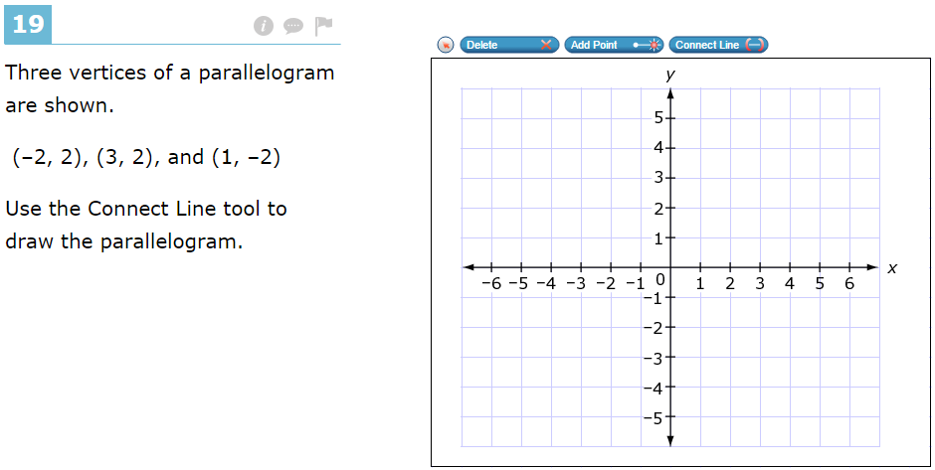
Answer
Click Here

Slide 28
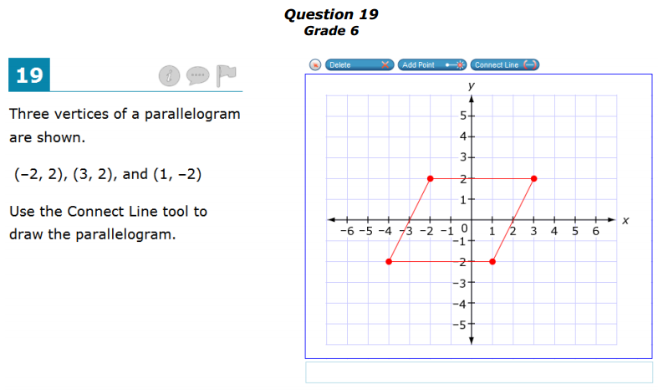
Solution
Students must know that a parallelogram has four sides. It has opposite equal length parallel sides, and opposite angles which are congruent.

Slide 29
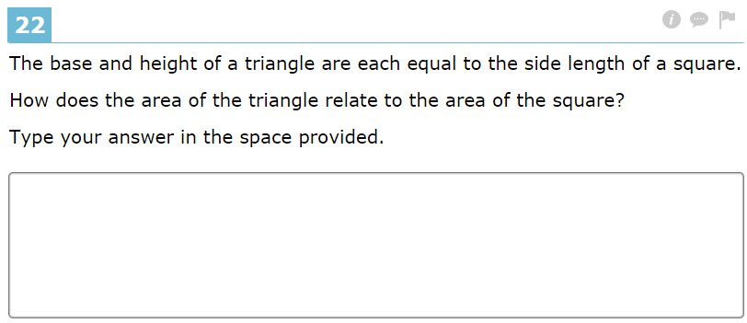
Answer
Click Here

Slide 30
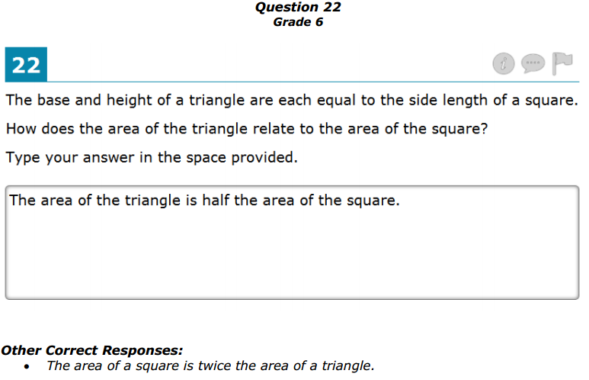
Solution
Area of a square is A = bh
Area of a triangle is A = ½ bh
therefore
the triangle’s area is one half of the square.

Slide 31
Milwee Middle School
We are proud of your child’s
efforts to learn!
Thank you for coming!

